Slide 1
Wage analysis using Additive Models
Ann Joseph, Jihye Park, Meher Pooja Pranavi Punyamanthula, Ross Graham

Slide 2
Introduction to the Topic/ Dataset
Generalized additive models (GAM)
Since the response variable in this analysis is a continuous variable
GAM structure : y = β₀ + ^{p} ∑ _{j=1} f_{j}(X_{j}) +ε
Why GAM?
It allows a non-linear relationship between the predictors and the response variable.
Mid-Atlantic Wage Data
Wage and other data for a group of 3000 male workers in the Mid-Atlantic region.
Response variable is “logwage”
Predictors: year, age, maritl, race, education, region, jobclass, health, health_ins
Mid-Atlantic Wage Data
Wage and other data for a group of 3000 male workers in the Mid-Atlantic region.
Response variable is “logwage” and the other 10 variables:

Slide 3
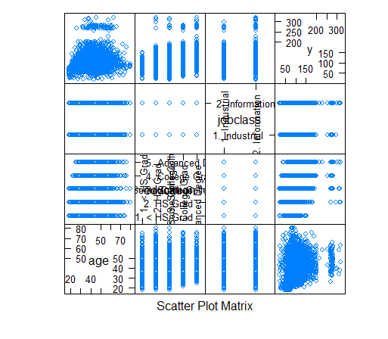
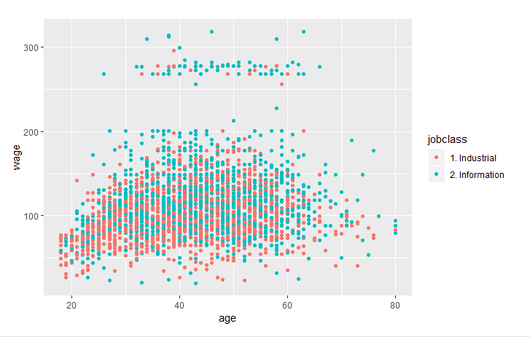
Exploratory Data Analysis

Slide 4
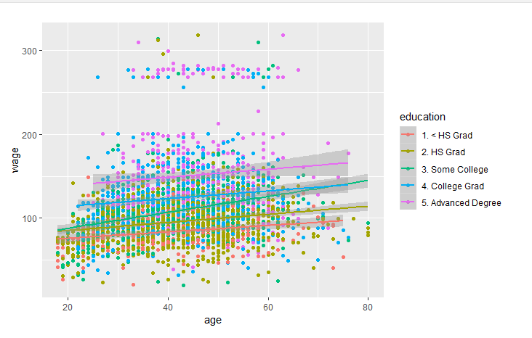

Exploratory Data Analysis
By connecting with previous figure we can say that most of the higher education
The wages were divided into 3 groups

Slide 5
Data Analytics using GAM
Linear model
Stepwise model selection by AIC.
Removed “jobclass” and “race” → only 6 predictors.
Adjusted R² is around 38%.
Suggesting non-linearity in the relationship between the response variable “logwage”, and the predictors.
AIC of this model was 585.03
olm = lm(logwage~., data = train)
olm = stepAIC(olm, trace = FALSE)

Slide 6
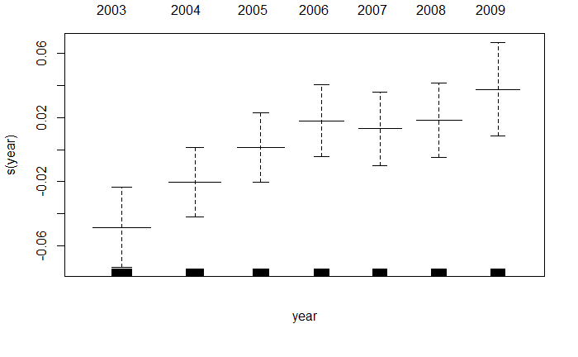
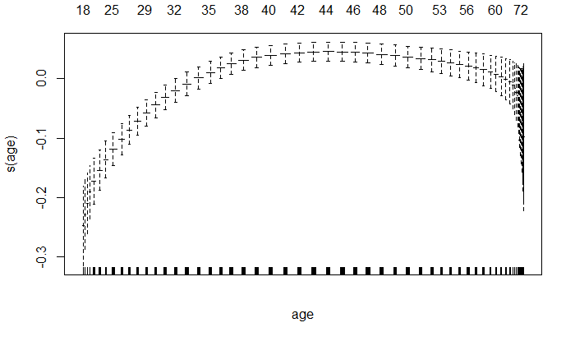
Data Analytics using GAM
Model 1 - all predictors, all continuous smoothing, no factor smoothing
AIC of the model is 531.
RMSE is 44.22
Adjusted R² is around 36%
model1 <- gam(logwage ~ s(year) + s(age)+ maritl + race
+ education + jobclass + health + health_ins,
data = train)
Notes:
Both graph shows the transformation of the year and the age.

Slide 7
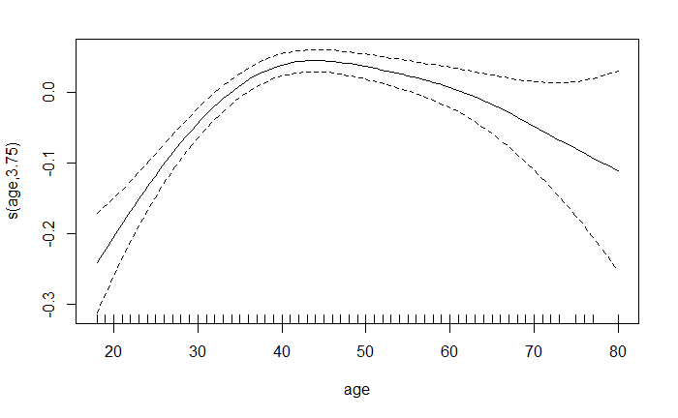
Data Analytics using GAM
model2 <- gam(logwage ~ year + s(age) + maritl + race
+ education + jobclass + health
+ health_ins, data = train)
Model 2 - all predictors, age smoothing, no factor smoothing
Inspired by the almost linear relationship in the “year”
Adjusted R² is around 40%
AIC of the model is 528.73
RMSE is 0.284
the y axis contains the nonlinear function, the x-axis contains the predictor used in the model and the dashed lines represent the standard error bands.
Notes:
Compare the significance of this change. The year of the p value is not large so that gives that the wage is increasing over time however, there is a time that is rapid or slower. Explain the graph,

Slide 8
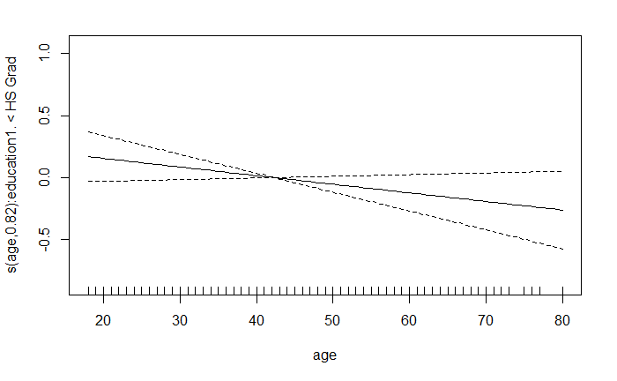
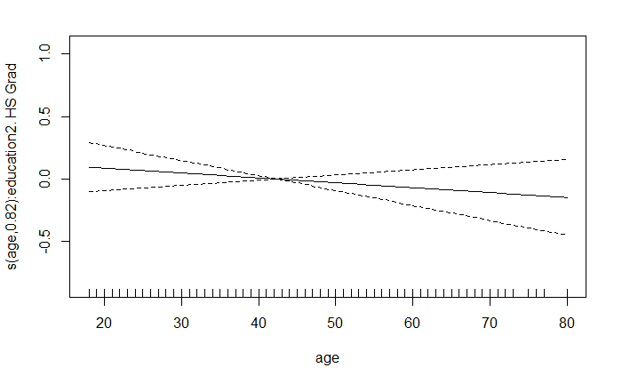
Data Analytics using GAM
Model 3 - all predictors, age smoothing, factor smoothing
By allowing age to have different smoothing functions for each level of a factor variable
Adjusted R² is around 42%
AIC of this model is 484.21
RMSE of 0.284.
← Transformation of age by education less than high school
→
Transformation of age by high school
education

Slide 9
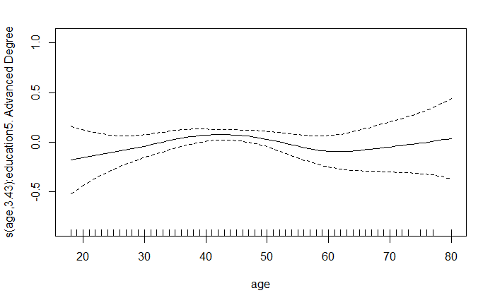
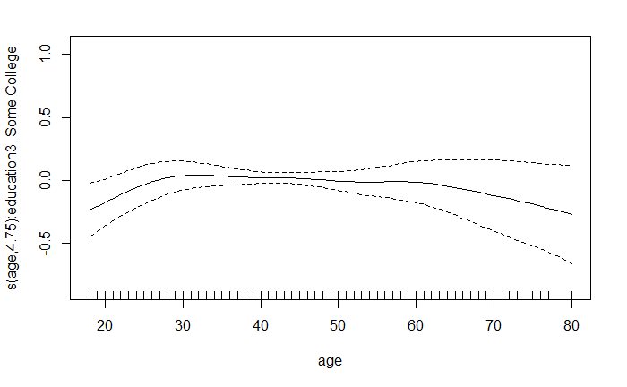

Data Analytics using GAM
← Transformation of age by ‘Some College’ education
Transformation of age by ‘Advanced Degree’ education
← Transformation of age by ‘College Grad’ education
model3 <- gam(logwage ~ year + s(age, by =maritl)
+ maritl + s(age, by = race) + race
+ s(age, by = education) + education
+ s(age, by = jobclass) + jobclass
+ s(age, by = health) + health
+ s(age, by = health_ins) + health_ins, data = train)

Slide 10
Data Analytics using GAM
Model 4 - fewer predictors, age smoothing, factor smoothing
Motivated by taking model 3
“Maritl” and “race” → do not have any factor levels where the smoothing component was significant.
AIC of 490.96 which is higher than the 484.21 of Model 3.
Adjusted R² is 41% and the RMSE is 0.283.
model4 = gam(logwage ~ year + maritl + race
+ s(age, by = education) + education
+ s(age, by = jobclass) + jobclass
+ s(age, by = health) + health
+ s(age, by = health_ins) + health_ins, data = train)

Slide 11
Data Analytics using GAM
Model 5 - classification model
Motivated by the idea that we may not wish to predict an exact wage, but rather whether an individual earns a wage over a certain level.
We are interested in a wage cut off of 100 ($100,000) → “logwage” cutoff of 4.60517.
Adjusted R² is around 32%.
AIC of this model is 2148.81
Y = as.factor(I(train$logwage > log(100)))
model5 = gam(Y ~ year + s(age, by = maritl)+ maritl + race
s(age, by = education) + education
s(age, by = jobclass) + jobclass + s(age, by = health)
health + s(age, by = health_ins) + health_ins,
data = train, family = binomial)

Slide 12
Other Models
Model 6 - ACE Model
Motivation of the model is to work with a transformed version of the response variable.
Adjusted R² is around 42%
Model 7 - AVAS Model
Motivation of the model is to trade off some fit accuracy to get constant variance.
Adjusted R² is around 40%
Model 8 - MARS with no Interactions
The MARS approach without interactions is a type of additive model.
Adjusted R² is around 41%
#Model 6
X = model.matrix(train$logwage ~ .,
data= subset(train, select = -c(logwage)))
acefit = ace(X,train$logwage)
model6 = lm(acefit$ty ~ .-1, data = data.frame(acefit$tx)
#Model 7
avasfit = avas(X,train$logwage)
y = avasfit$ty
x = avasfit$tx
model7 = lm(y ~ . -1, data = data.frame(x))
#Model 8
model8 = earth(logwage ~ . ,
data = train, degree = 1)

Slide 13
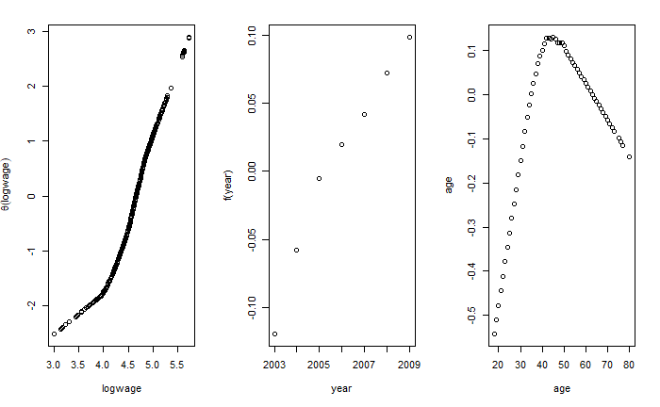
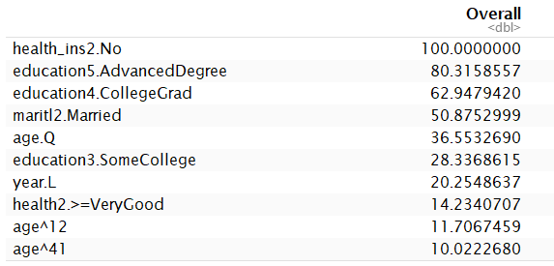
Transformation of Response (ACE and AVAS) & Important Variables given by MARS

Slide 14
Conclusion/Discussion
Model | Adjusted R² | AIC | RMSE
Linear Model | 38% | 585.03 | 0.2843646
Model 1 | 36% | 531 | 44.22
Model 2 | 40% | 528.73 | 0.281
Model 3 | 42% | 484.21 | 0.2844065
Model 4 | 41% | 490.96 | 0.283

Slide 15
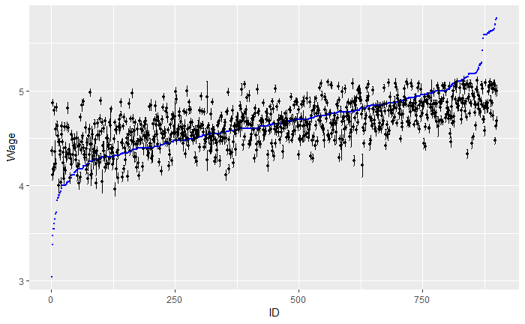
Conclusion/Discussion
The blue dots represent the actual values of wage in the test set and the black dots are the predictions made by Model 3 along with prediction intervals

Slide 16
References
James, G., Witten, D., Hastie, T., and Tibshirani, R. (2013) An Introduction to Statistical Learning with applications in R. Springer
Faraway J. J. (2009). Extending the Linear Model with R (Second Edition). Chapman & Hall/CRC

